Slide 1
DA 507 modeling and optimization
Week 6
Stochastic Processes
Continuous Time Markov Chains
Kerem Bülbül & Güvenç Şahin

Slide 2
Continuous Time Stochastic Processes
In previous models, time was discrete, i.e., t = 0, 1, …
However, in many stochastic processes the system is observed continuously over time, i.e., t ≥ 0.
Now, we will discuss properties of continuous stochastic processes with the Markovian property.
Continuous time Markov chains also provide a link to the queueing theory.

Slide 3
Continuous Time Stochastic Processes
Let X(t) be the state of the continuous stochastic process {X(t), t ≥ 0} at time t.
X(t) takes one of its possible values over some interval 0 ≤ t < t₁, then will jump to another value over the interval t₁ ≤ t < t₂, etc.
These points in time t₁, t₂, … are random variables, and they are not necessarily integers.

Slide 4
Markovian Property for
Continuous Time Stochastic Processes
A continuous time stochastic process {X(t), t ≥ 0} is said to have the Markovian property if for all s, t ≥ 0, x(r), 0 ≤ r < s, and for all states i, j, we have
Current time
0
r
s
s+t
Transition probability

Slide 5
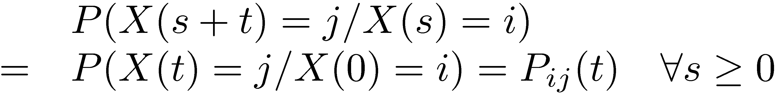
Stationary Transition Probabilities
If the probability above is independent of the current time s, i.e.,
We say that the transition probabilities are stationary.

Slide 6
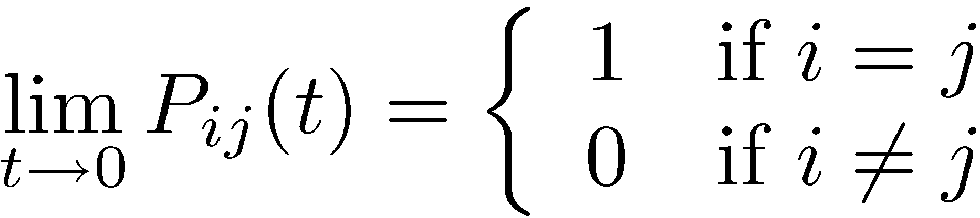
Continuous Time
Transition Probability Function
P_{ij}(t) is the probability that the system is in state j after t units of time given that it is currently in state i.
We assume that
Notes:
This limit corresponds to P(X_0 = j / X_0 = i) in discrete time Markov chains.

Slide 7
Continuous Time Markov Chains
A continuous time stochastic process {X(t), t ≥ 0} is a continuous time Markov chain if it has the Markovian property.
In this course, we assume that the transition probabilities are stationary.

Slide 8
Some Key Random Variables
Each time the process enters state i, the amount of time it spends in that state is a continuous random variable T_{i}, i=0,1, …,M.
Suppose that the Markov chain enters state i at some time, say zero, and does not leave it for the next 10 time units. What is the probability that the process does not leave state i during the following 5 time units?

Slide 9
Some Key Random Variables
In other words, what is P(T_{i} >15 / T_{i} >10)?
By the Markovian property, this probability must equal P(T_{i} > 5).
More generally,
So, T_{i} is a memoryless continuous random variable and must be exponentially distributed.
E(T_{i}) = 1 / q_{i} and P(T_{i} ≤ t) = 1 – e^{-qit} ∀ t ≥ 0.
Notes:
There is only one memoryless continuous distribution.

Slide 10
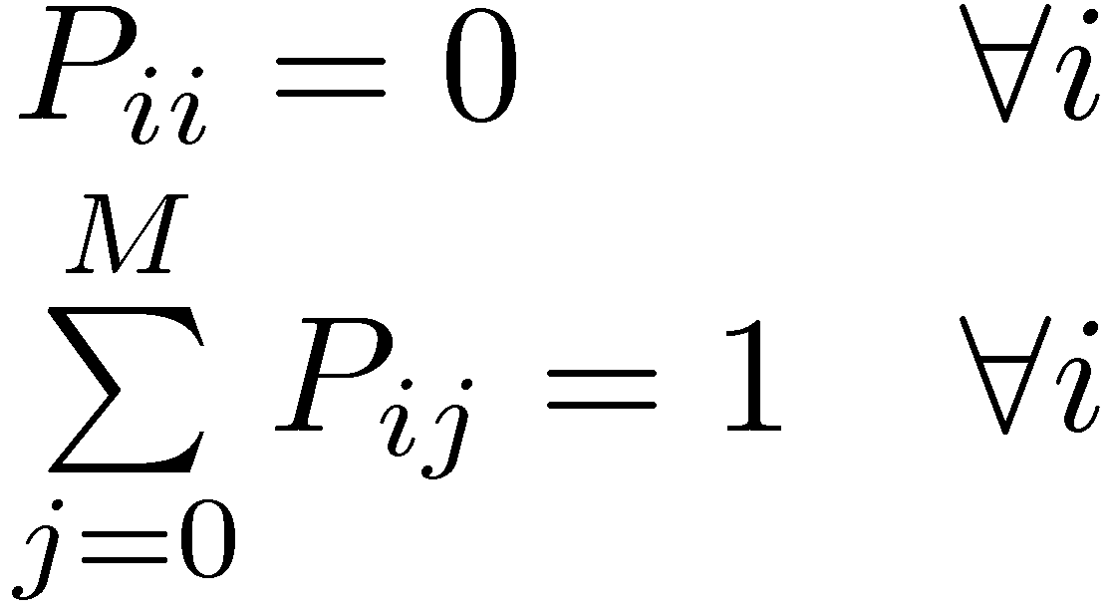
Continuous Time Markov Chains
Alternatively, a continuous time Markov chain is a stochastic process such that
  The amount of time spent in state i before making a transition into some other state is distributed exponentially with mean 1 / q_{i}.
  When the process leaves state i, it next enters state j with some probability P_{ij}. These probabilities satisfy
  The next state visited is independent from T_{i}.
Notes:
If the next state visited and T_i were not independent, then we could infer information about the next state from the amount of time spent so far in state i, and this would violate the Markovian property.

Slide 11
Continuous Time Markov Chains
In other words, a continuous time Markov chain is a continuous process that moves from state to state according to a discrete time Markov chain, but is such that the amount of time spent in each state, before proceeding to the next state, is exponentially distributed.
A continuous time Markov Chain has an underlying Discrete Time Markov Chain.

Slide 12


Two Useful Properties of Exponential Distribution
X₁ is exponentially distributed with mean 1/λ₁,
X₂ is exponentially distributed with mean 1/λ₂,
X₁ and X₂ are independent.
⇒min(X₁, X₂) is exponentially distributed
with mean 1 / (λ₁ + λ₂).
Two exponential alarm clocks ticking
⇒P(X₁ < X₂) = λ₁ / (λ₁+λ₂) and P(X₂ < X₁) = λ₂ / (λ₁+λ₂).
Which alarm rings first?
Notes:
Mention that the rate of the distribution min(X₁, X₂) is the sum of the rates of X₁ and X₂.

Slide 13
Continuous Time Markov Chains
BEWARE: This time we are dealing with two components.
  The time spent in state i before transitioning into another state.
    This does not take into account the probability of transitioning into state j.
  The probabilities of transitioning into different states.
    This does not take into account the rates at which the transitions occur.
Hence transition rates

Slide 14
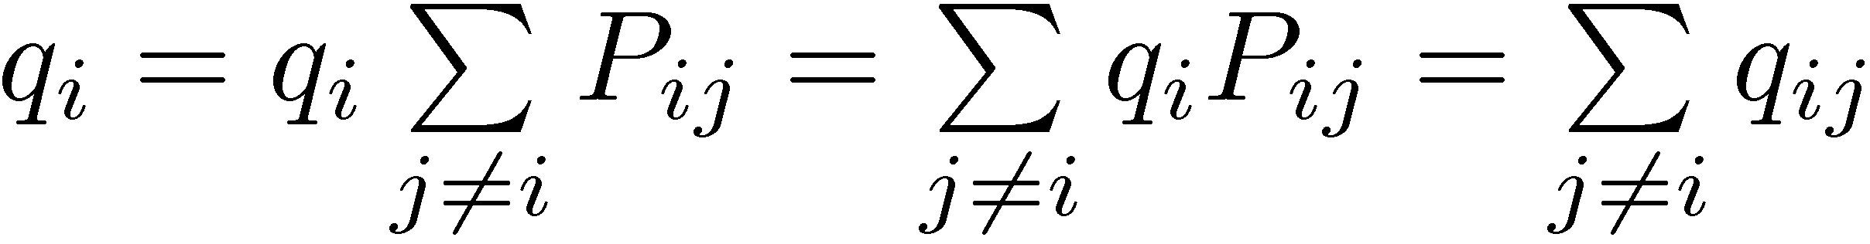
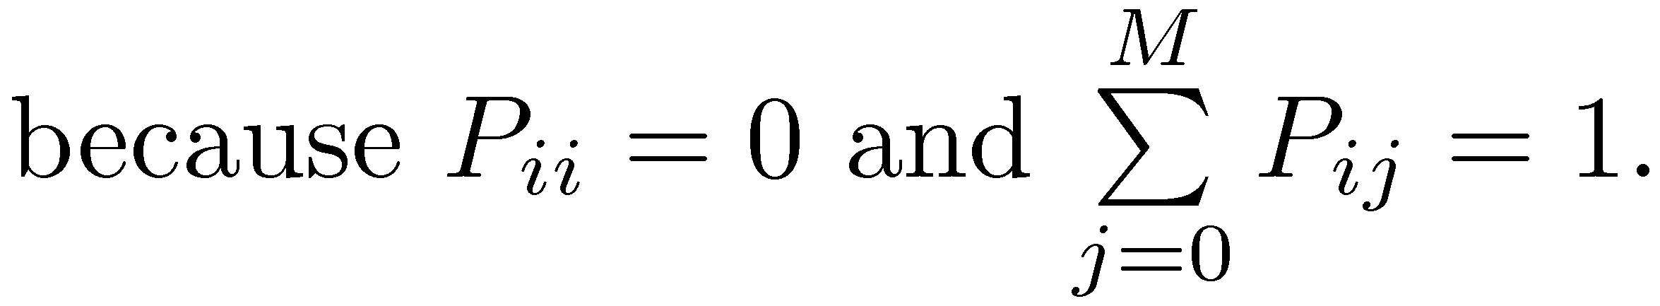
Transition Rates
q_{i}, i.e., the rate of the exponential distribution T_{i}, is the rate of transition out of state i.
q_{ij}=q_{i}*P_{ij} is the rate of transition into state j from state i.
We also have

Slide 15
Example
A machine shop has two identical machines and a single repair person
Time until the next breakdown is exponentially distributed with a mean of 1 day (for each machine)
Time required for repair is exponentially distributed with a mean of ½ days

Slide 16
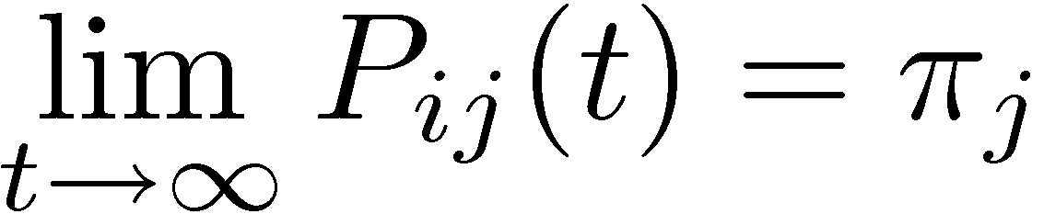
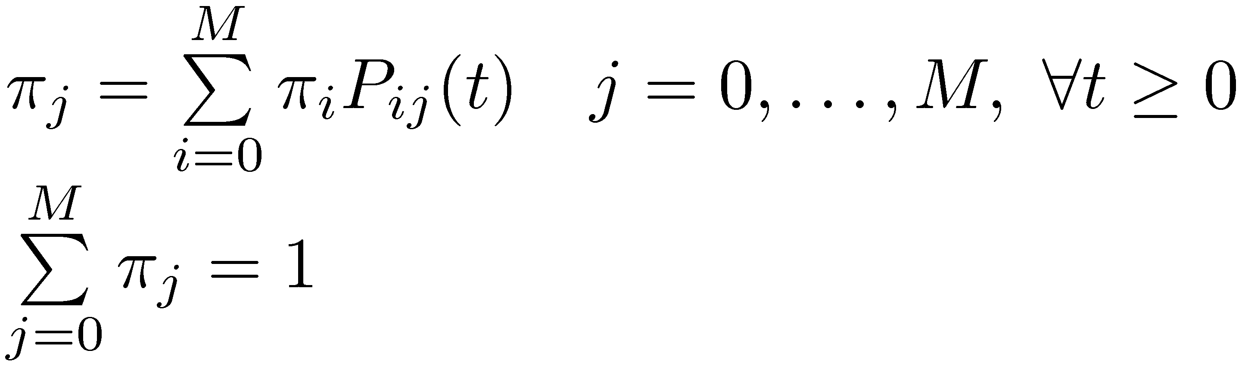
Steady-State Probabilities
For any irreducible finite-state continuous time Markov chain (periodicity and therefore ergodicity does not apply to continuous time Markov chains), exists and is independent of i. Furthermore, π_{j}’s uniquely satisfy the following equations:

Slide 17
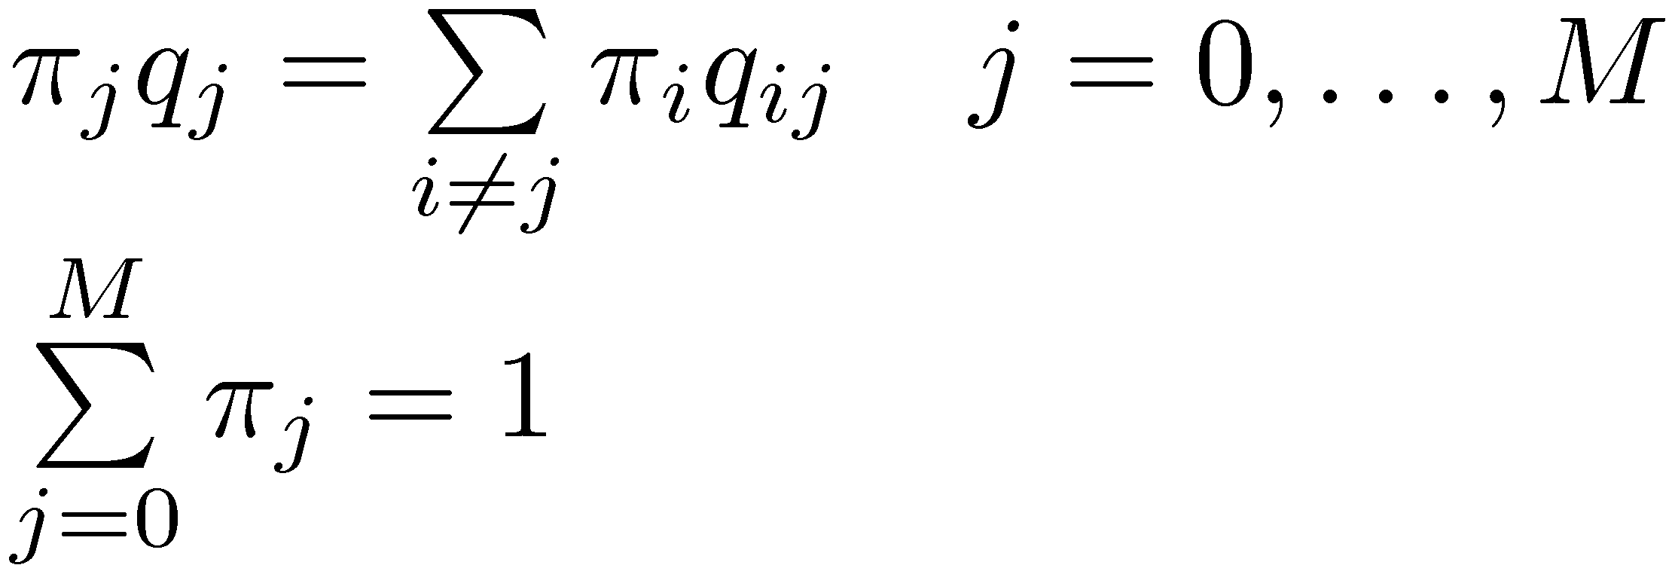
Steady-State Probabilities
However, a more useful system of equations for obtaining the steady-state probabilities is based on the rates of transition.

Slide 18
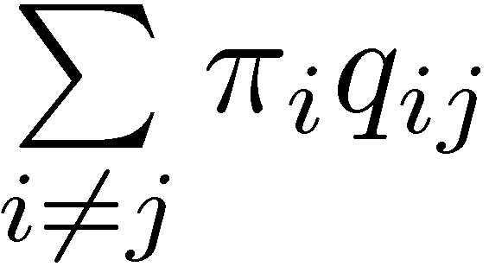
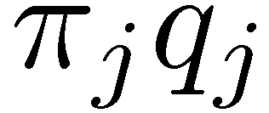
Steady-State Probabilities
Rate of transition into state j
=
Rate of transition out of state j
j
=
Balance Equation
π_{j}’s have three interpretations as before
  Limiting probabilities.
  Steady state probabilities.
    Long term proportion of time spent in state j is π_{j}.
  Stationary probabilities.

Slide 19
Example
Continue with the machine shop example.

Slide 20
Queueing Models Based on
Continuous Time Markov Chains
Most widely used models in queueing theory are based on a special type of continuous time Markov chain referred to as the birth-and-death process.
In this framework, the interarrival times of the customers and the service times are exponentially distributed.
  These interarrival and service times are all independent from each other.
  We frequently also assume that the service time distributions as well as the interarrival time distributions are identical. This is generally not a required assumption.

Slide 21
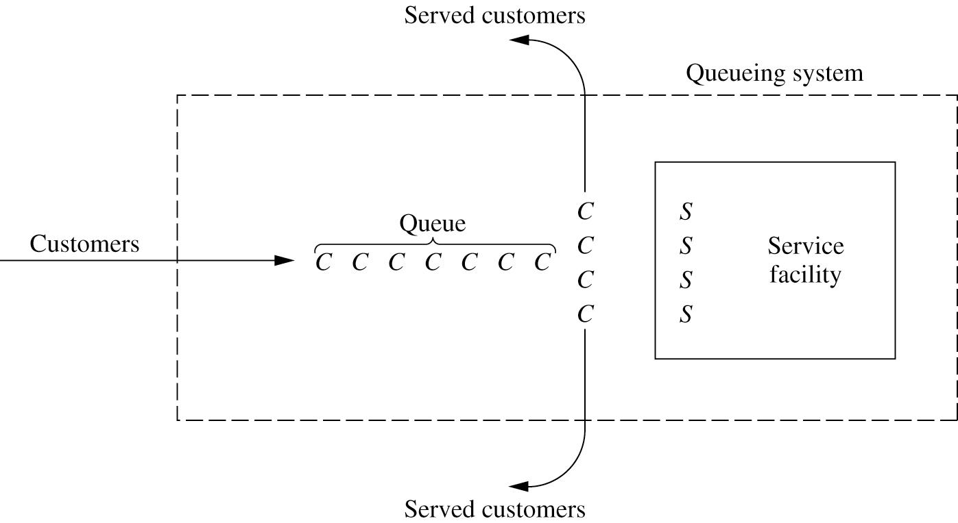
An Elementary Queueing Process
We restrict our attention to the type of system below.

Slide 22
The M/M/s Model
Independent and identically distributed exponential interarrival and service times.
  The rate of the interarrival time distribution is λ.
  The rate of the service time distribution is μ.
  M in the notation stands for Markovian. Recall that the exponential distribution is memoryless.
The number of parallel servers is s.

Slide 23
The M/M/s Model
The transition rate diagram of the resulting Markov chain is:
Queue starts
s = 1
λ
λ
λ
λ
λ
λ
0
1
2
3
…
n-3
n-2
n-1
n
…
μ
μ
μ
μ
μ
μ
s > 1
Queue starts
λ
λ
λ
λ
λ
λ
0
1
2
3
…
s-2
s-1
s
s+1
…
μ
2μ
3μ
(s-1)μ
sμ
sμ

Slide 24
Steady-State Probabilities for M/M/1
λ
λ
λ
λ
λ
λ
0
1
2
3
…
n-3
n-2
n-1
n
…
μ
μ
μ
μ
μ
μ
Balance equations for a continuous time Markov chain.
Note that we allow for an infinite number of states here.

Slide 25
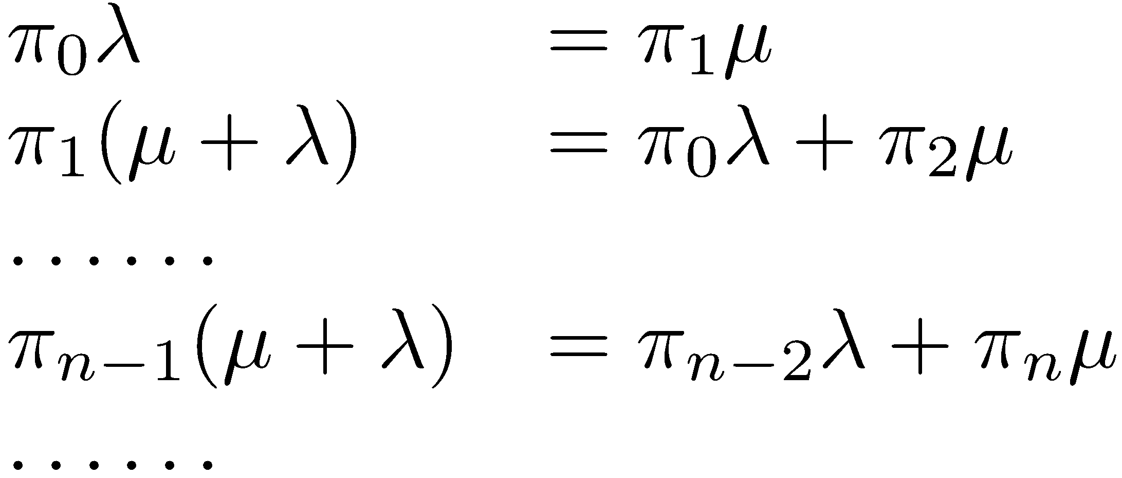
Steady-State Probabilities for M/M/1
λ
λ
λ
λ
λ
λ
0
1
2
3
…
n-3
n-2
n-1
n
…
μ
μ
μ
μ
μ
μ
Always one more variable than the number of constraints.
So, we solve for all π_{j}’s in terms of π₀, and then use ∑ π_{j} = 1 to obtain π₀ first.

Slide 26
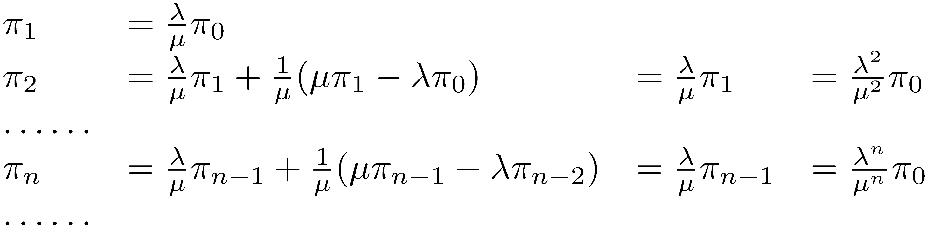
Steady-State Probabilities for M/M/1
λ
λ
λ
λ
λ
λ
0
1
2
3
…
n-3
n-2
n-1
n
…
μ
μ
μ
μ
μ
μ

Slide 27
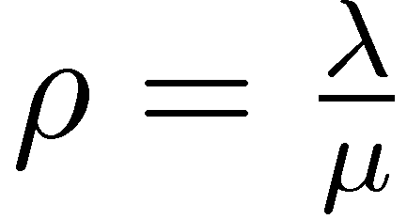
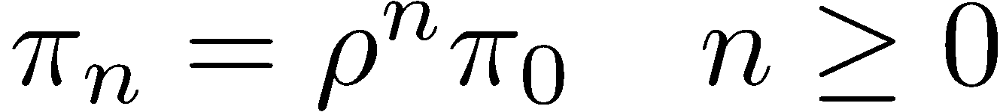
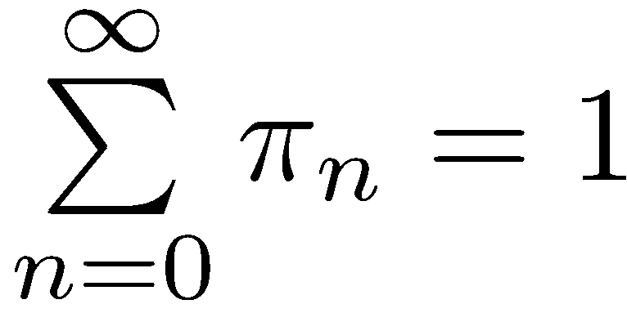
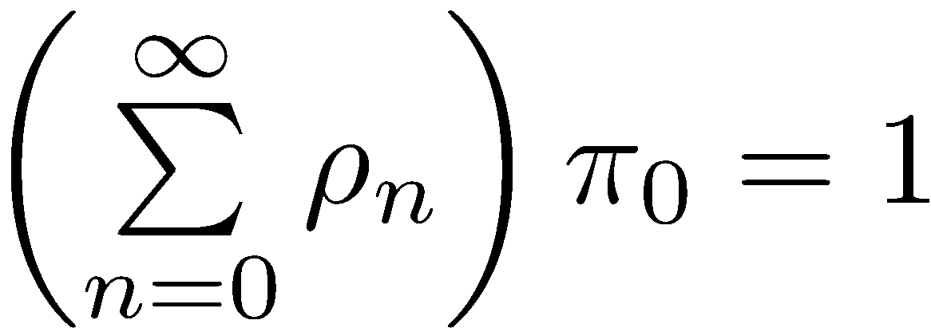
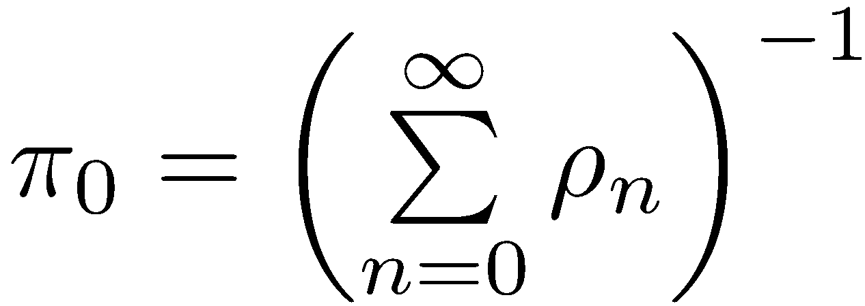
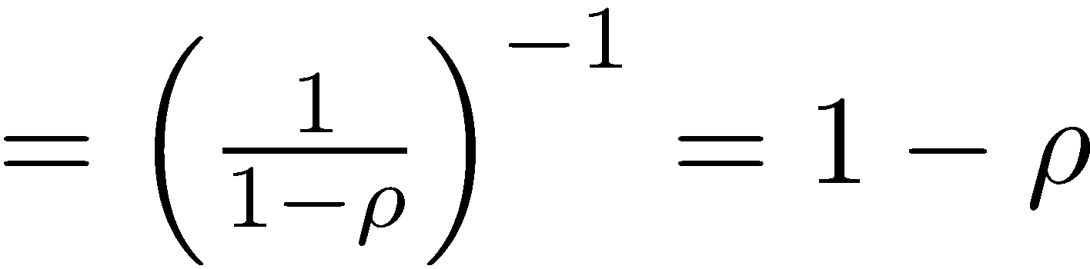
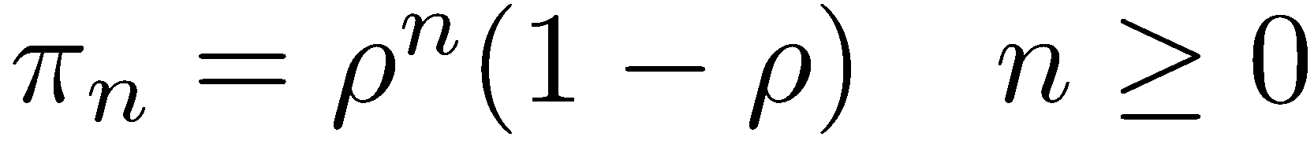
Steady-State Probabilities for M/M/1
If we define :
Valid only if ρ < 1
27

Slide 28
Server Utilization
For a queueing system with s identical parallel servers with a service rate of μ per server and an arrival rate λ of customers, the utilization factor ρ of the system is given by ρ =λ / (sμ).
The utilization factor represents the expected proportion of time an individual server is busy.
Note that λ / (sμ) can be interpreted as the fraction of service capacity sμ that is being utilized on average by arriving customers.
Notes:
The utilization factor represents the expected proportion of time an individual server is busy. For this statement to hold, an idle server must be chosen randomly for a customer entering service.

Slide 29
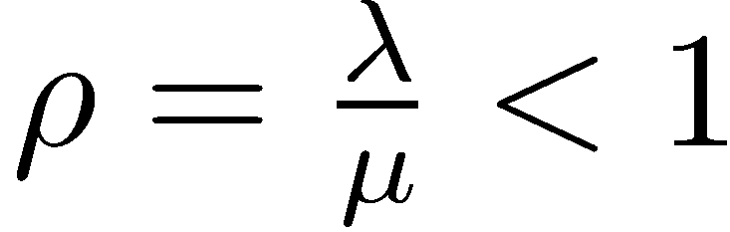
Existence of a
Steady-State for M/M/1
The steady-state distribution does only exist if
This makes a lot of sense! ρ is the server utilization, and no steady-state exists if the server cannot keep up with the arrival of the customers.
  What happens to the queue length in this case?

Slide 30
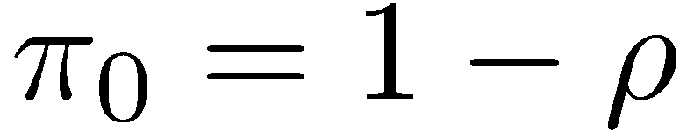
Steady-State Probabilities for M/M/1
Why does this formula make sense?
What is ρ?
  Utilization of the server.
  Utilization is the long run proportion of time the server is busy.
  The server is busy whenever n ≥ 1.
  So, there is nobody in the system only when the server is idle.

Slide 31
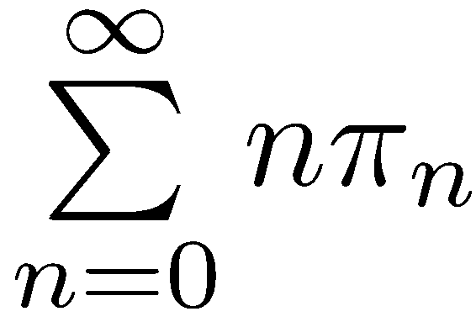
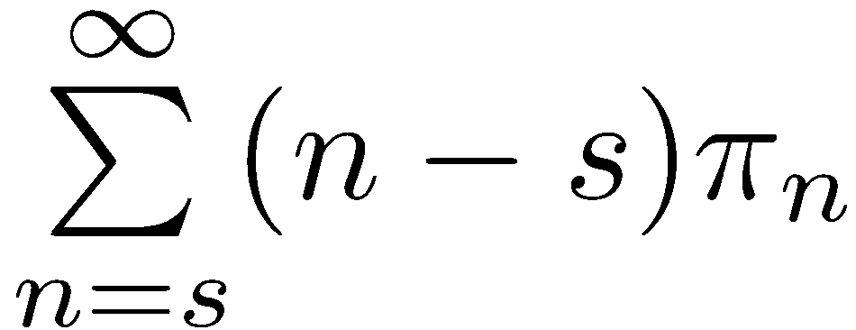
Steady-State Condition
In a steady-state condition
  π_{n} = probability of having exactly n customers in the system.
  L = expected number of customers in the system =
  L_{q} = expected queue length =
  E(time in the system for each customer) = W
  E(time in the queue for each customer) = W_{q}
The four quantities L, L_{q}, W, W_{q} are fundamental in the analysis of queueing systems.

Slide 32
Little’s Law
L = λW
In other words, the expected number of customers in the system is the product of their mean arrival rate and the expected time a customer spends in the system.
Little’s formula does also apply to the queue.
  L_{q} = λW_{q}

Slide 33
Little’s Law
Little’s law is very powerful, and it applies to almost all queueing models regardless of the arrival process, the number of servers or the queue discipline.

Slide 34
Expected Time in Queue
What is the relationship between the expected time W in the system, the mean service time 1 / μ and the expected time W_{q} in the queue?
  W = W_{q} + 1/μ

Slide 35
Fundamental
Performance Measures
We can determine all of the fundamental performance measures L, L_{q}, W, W_{q} by applying the formulas below as soon as one of the four quantities is determined.
  L = λW
  L_{q} = λW_{q}
  W = W_{q} + 1/μ

Slide 36
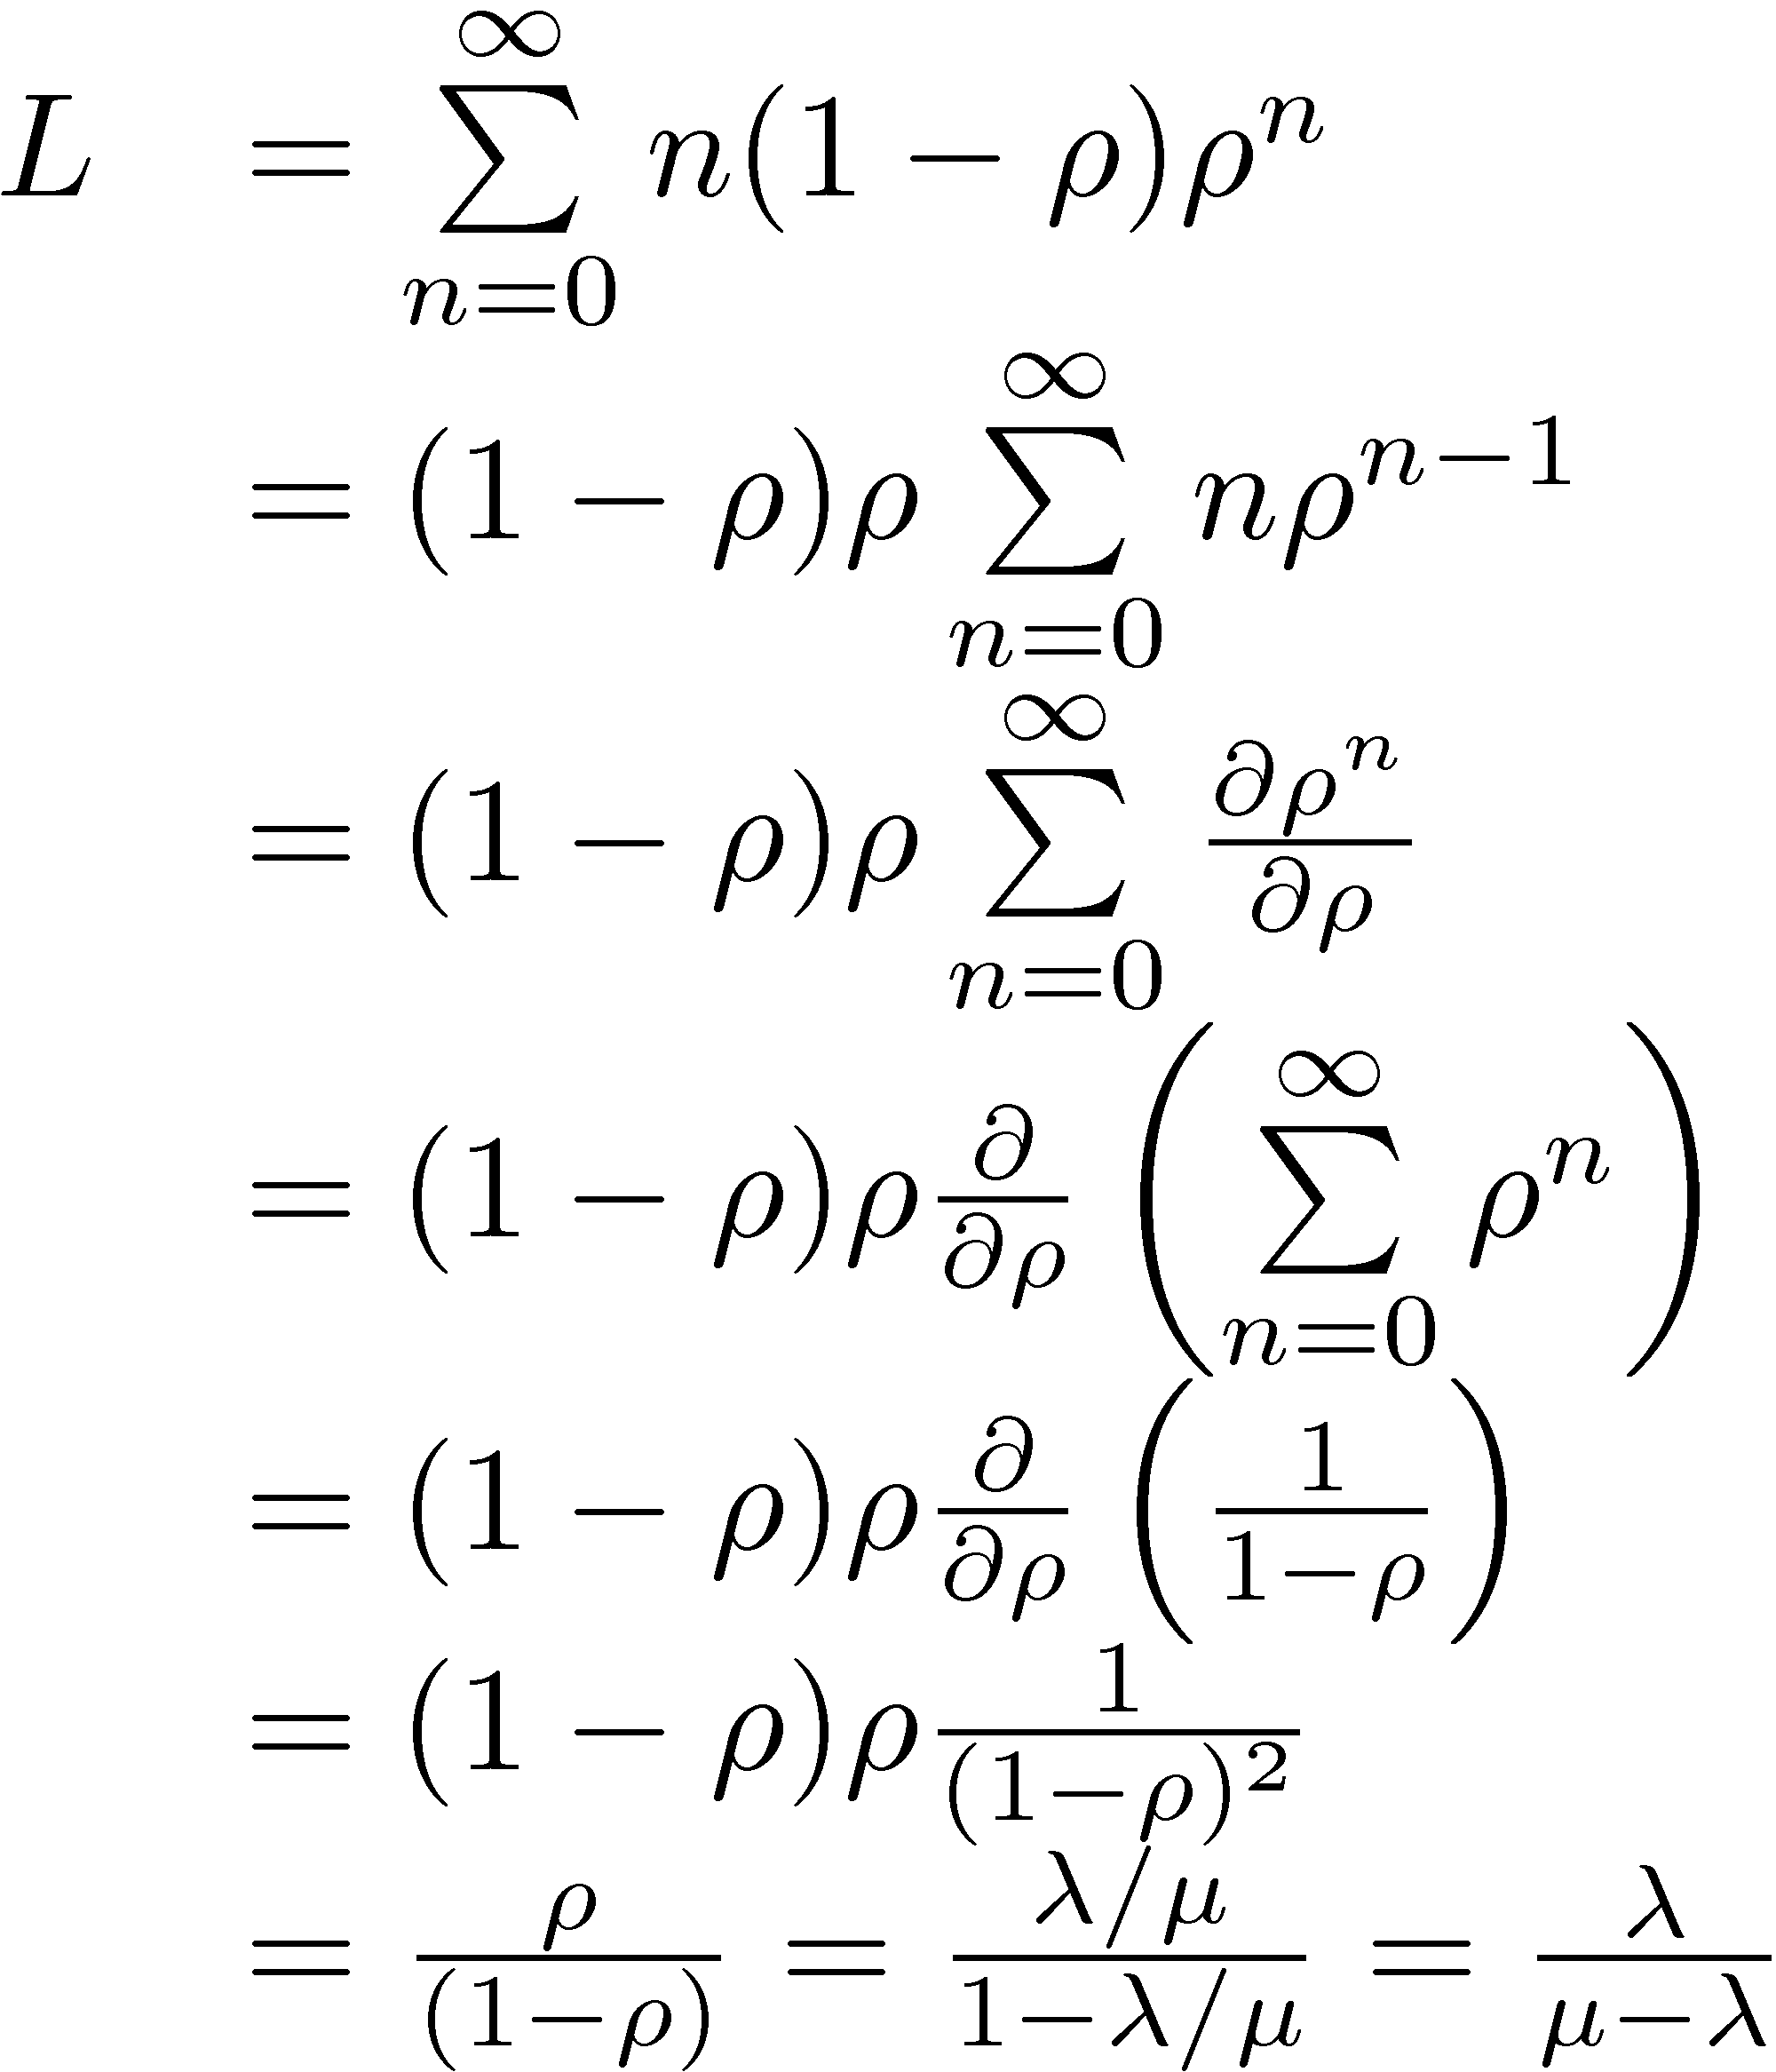
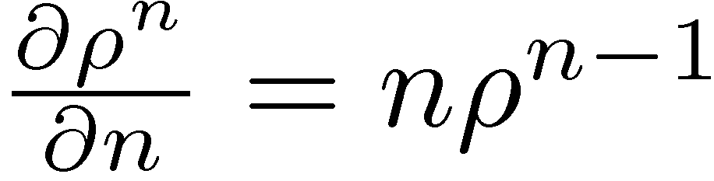
The M/M/1 Model
Expected # of Customers in System
Sum of derivatives = Derivative of the sum
Sum of geometric series

Slide 37
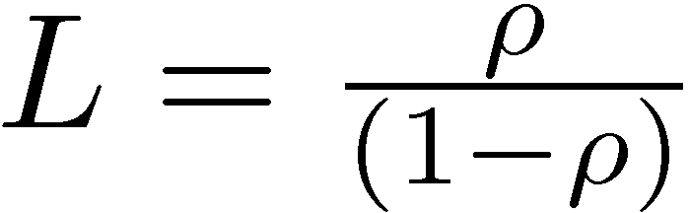
The M/M/1 Model
Load On The System
What happens to the expected number of customers in the system as the server starts working almost all the time?
  L grows rapidly as ρ = λ / μ approaches 1.
  Thus, the queue grows without bound in the long run if λ ¸ μ.

Slide 38
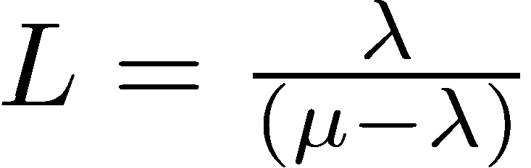
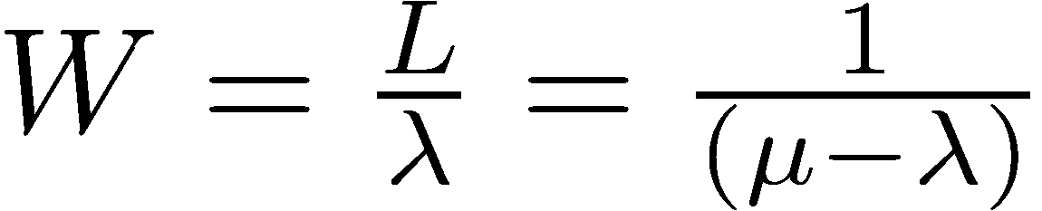
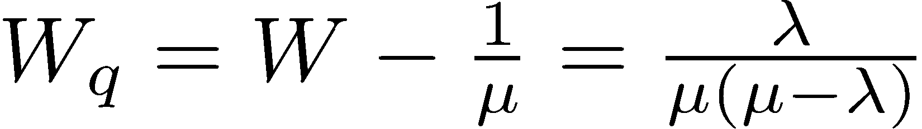
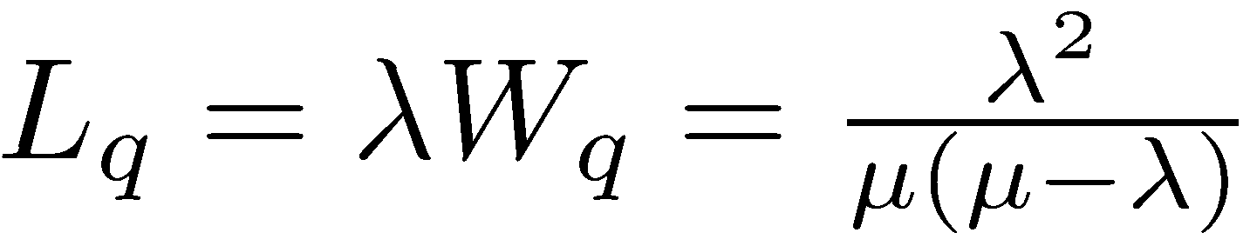
The M/M/1 Model
Fundamental Performance Measures

